Slide 1

Code Club

Slide 2
Code Club Initiative
The British Council is leading the Code Club initiative in Egypt this year.
Code Club is a world-leading programming initiative for students aged 9-13. It aims to develop their basic coding and programming skills in a fun, interactive, and collaborative manner.
Code Club is one of the Raspberry Pi Foundation's largest programs, with a presence in over 160 countries worldwide.
The competition theme for the last academic year is 2023-2024 “Global Warming”

Slide 3
Theme: Water Conservation Heroes
The Code Club Competition is a wonderful opportunity for students to showcase their coding skills using Scratch programming to raise awareness about global warming, the development of sustainable solutions, the importance of saving water.
whether through storytelling, games, animations, audio narration, or typed text, creativity is key.
Students will create projects that highlight key issues such as water scarcity, pollution, and sustainable water management.

Slide 4
Theme Tips:
* Explore Water Scarcity: Research regions facing water shortages and their challenges.
* Understand Water Pollution: Study the causes and effects of water pollution.
* Promote Water Conservation: Develop strategies for reducing water usage.
* Innovate for a Water-Secure Future: Explore cutting-edge water technologies and solutions

Slide 5
Project Submission Guidelines
* Team Size: 3-5 students
* Software: Scratch
* Project Duration: 3-5 minutes
Understand the expected project format: Scratch-based, 3-5 minute project
* Submission Deadline: 27th of April 2025

Slide 6
Judging Criteria
* Effectiveness of chosen characters: How well do the characters represent the theme and convey the intended message?
* Originality and creativity of the idea: Does the project present a unique and innovative approach to addressing the theme?
* Relevance of the idea to the theme: Does the project clearly relate to the theme of Water conservation?
* Effectiveness of aids used to demonstrate the idea: How effectively do the Scratch software, audio narration, typed text, and other communication methods enhance the project?
* Clarity and impact of the issue introduction and proposed actions: Is the issue of water conservation clearly introduced and are the proposed solutions feasible and impactful?

Slide 7
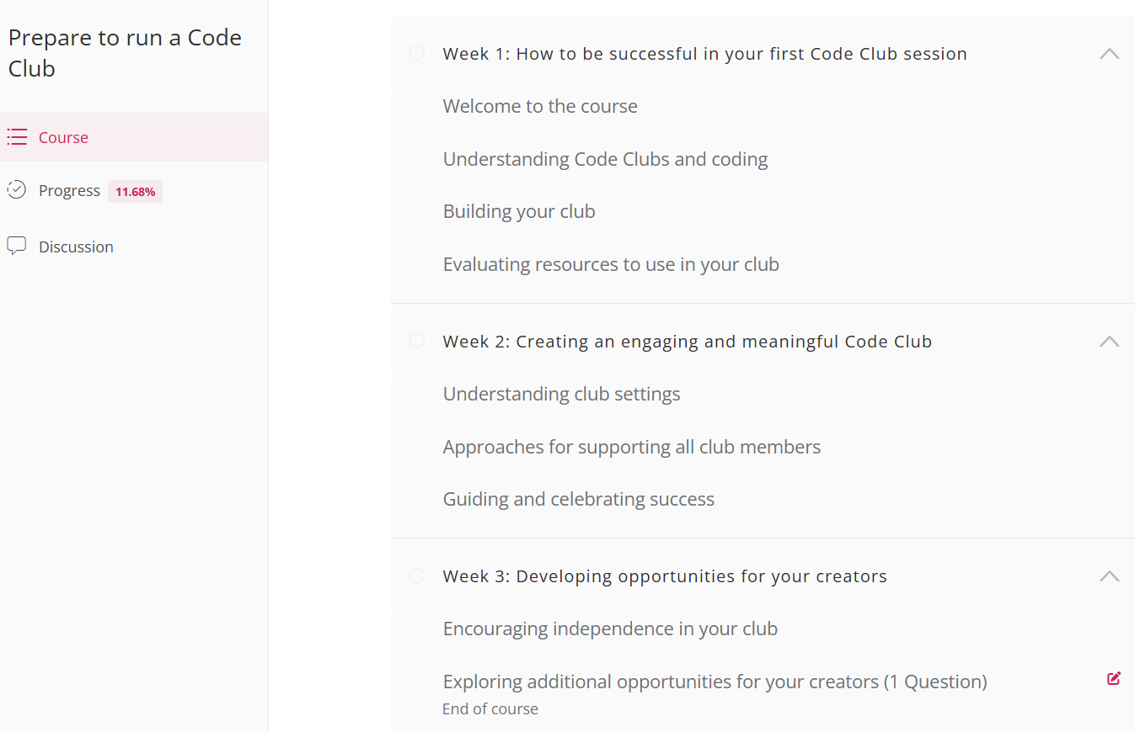
Online Training Course
A clicker-style game where players save water by fixing leaks, turning off taps, and using water-efficient devices

Slide 8
Scratch Projects

Slide 9
Water Saver Game
A clicker-style game where players save water by fixing leaks, turning off taps, and using water-efficient devices
How it works:
The player sees different water-wasting scenarios (e.g., leaking tap, running shower, overflowing tank).
The player must click on the correct object to stop the water waste.
Points increase for each correct action, and a hero badge appears when they reach a certain score.
A timer adds a challenge to save as much water as possible before time runs out.

Slide 10
Scratch Features Used:
✔️ Sprite animation (taps dripping, pipes bursting)
✔️ Click detection to stop water waste
✔️ Score tracking
✔️ Sound effects (water dripping, fixing leaks)

Slide 11
Water Hero Story Animation
An animated storytelling project where a character learns how to save water and becomes a "Water Conservation Hero."
How it works:
The main character wastes water at first (long showers, leaving taps open).
A wise old water drop appears and teaches them how to save water through speech bubbles.
The character starts taking action (turning off taps, using rainwater collection).
At the end, they earn a superhero badge for their water-saving efforts.

Slide 12
Scratch Features Used:
✔️ Backdrop changes (home, school, garden)
✔️ Speech bubbles for dialogue
✔️ Broadcast messages to move between scenes
✔️ Sound effects (water running, fixing pipes)

Slide 13
Water Usage Quiz Game
An interactive quiz where players answer multiple-choice questions about water conservation.
How it works:
Players choose an answer to a question (e.g., "How much water does a dripping tap waste in a year?").
Correct answers earn points and fun animations (e.g., a dancing water drop).
At the end, the player is given a Water Hero Rank (Beginner, Pro, Master)

Slide 14
Scratch Features Used:
✔️ Ask and answer blocks for user input
✔️ Variables for score tracking
✔️ If-else conditions to check answers
✔️ Animated feedback for correct/incorrect answers

Slide 15
Rainwater Collector Simulation
A simulation showing how rainwater can be collected and used efficiently.
How it works:
Rain falls from clouds, and the player must drag buckets or tanks to collect water.
If water falls on the ground, it's wasted.
After collecting water, the player can use it for plants, cleaning, or flushing to earn points.

Slide 16
Scratch Features Used:
✔️ Gravity effects (falling rain drops)
✔️ Drag-and-drop mechanics for moving water collectors
✔️ Point system for effective water use
✔️ Sounds and animations for engagement

Slide 17
Water Cycle Adventure
An educational animation explaining the water cycle in an interactive way.
How it works:
The player follows a water droplet’s journey through evaporation, condensation, precipitation, and collection.
At each stage, they interact with the environment (e.g., clicking the sun to start evaporation).
Fun facts appear, and at the end, the player earns a Water Conservation Hero badge.

Slide 18
Scratch Features Used:
✔️ Motion effects to move water through the cycle
✔️ Broadcast messages to guide the story
✔️ Click interactions to trigger animations
✔️ Educational voiceover or text narration

